Slide 1
Rabbit MQ
https://github.com/uvasistha

Slide 2
Pre Requisite
Install in following order in background to save time
1.ERLANG
2.RABBIT MQ
Enable management plugin
Command :
Go to http://localhost:15672 to see the UI
Use guest as default id and password
rabbitmq-plugins enable rabbitmq_management

Slide 3
What is Messaging ?
Form of communication b/w 2 entities
For software it means loosely coupled applications
Why do we need Messaging ?
Synchronous: HTTP, Server Client, RPC Methods etc.
This means tight coupling among entities. (Like Marriage)
A MEESAGING SHOULD BE LOOSELY COUPLED
Advanced Messaging Protocols target to solve this

Slide 4
Popular Messaging Protocol
Stomp Simple text messaging protocol Can use any stomp client to talk to stomp broker in multi Lang and platform Simple doesn’t have queues and exchange concepts It use send semantics and destination to send message Consumer subscribe to this destinations
MQTT Majorly for IoT and mobile, Standard, pub-sub model, big backing companies, used for small devices, Lightweight (no meta data) AWS ,Azure and Green grass Edge has mqtt based implementation
AQMP Advanced message queuing protocol Multi platform and multi vendor interoperability Uses queues topic, routing, transaction, exchange, security etc. POWER :JP Morgan use it (billion messages a day :0)

Slide 5
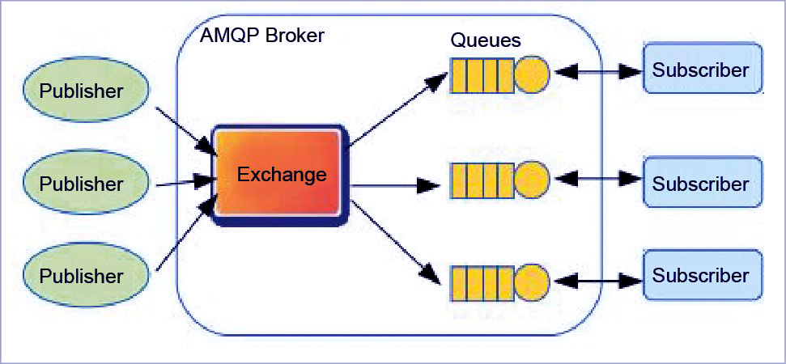
AMQP

Slide 6
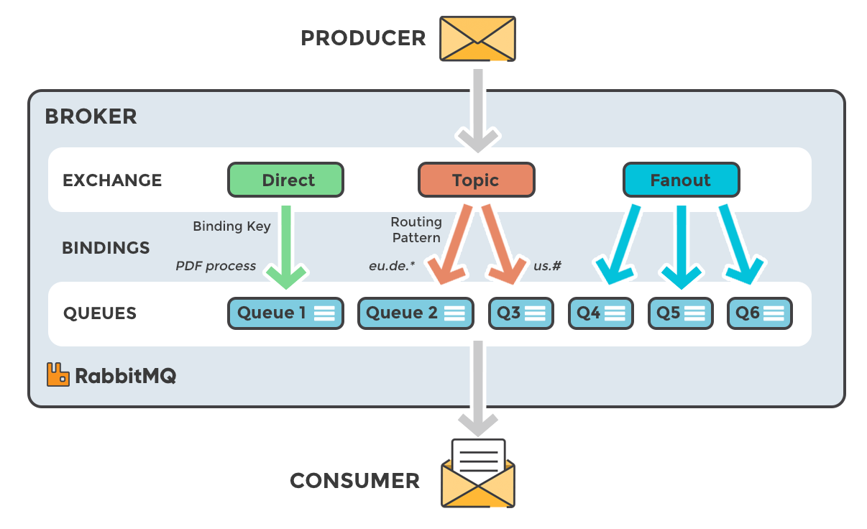
Rabbit MQ
Popular implementation of AMQP

Slide 7
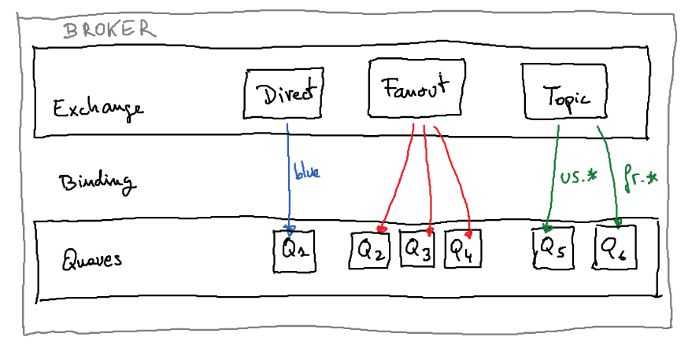
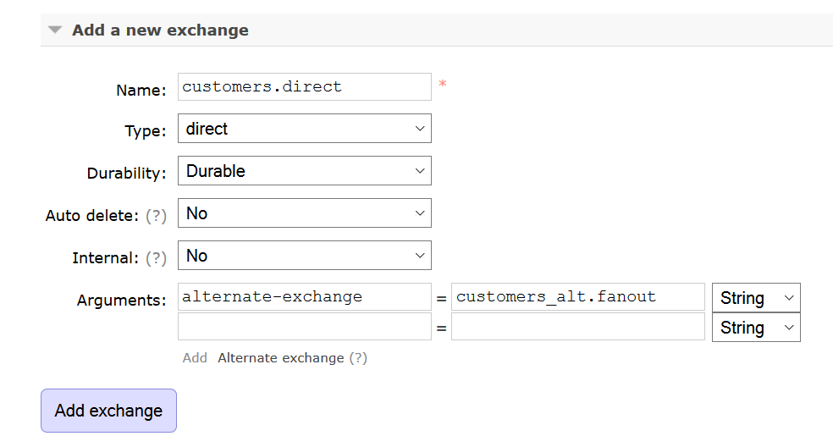
Pillars of AMQP : Exchange
1. Messages comes to exchange here first.
2. It takes the message and route to one or more queues.
3. Routing Algorithm decides where to send messages from queue.
4. Routing Algorithm depends in exchange type and binding(rules).
5. Bindings just bind exchanges to the queue.

Slide 8
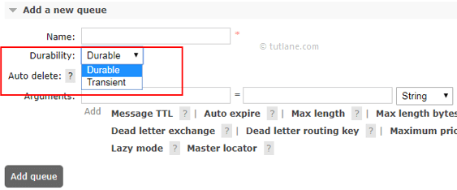
Pillars of AMQP : Queues
Queues are final destination where message goes in AMQP

Slide 9
Pillars of AMQP : Topics
Like subject part of email
Like a routing key for grouping messages
Format : apps.prod.main or apps.prod.logs
Topic Exchange use Topics
By Default no topic is there

Slide 10
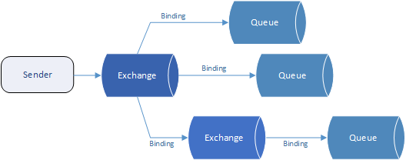
Pillars of AMQP : Bindings
Rules that exchange use to route message to queue
To instruct an exchange E to route some message M to Queue Q E must me bound to Q
If E is not bound to some Q, then it could be dropped or returned.
Analogy
Airport -> Exchanges
Destination -> Queue
Roads -> Binding

Slide 11
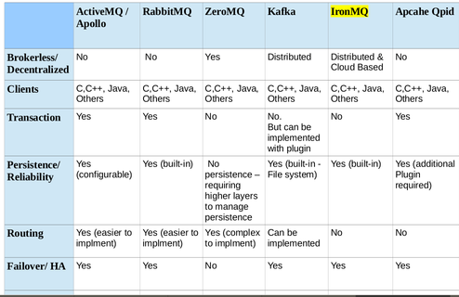
Rabbit MQ vs Others

Slide 12
HANDS ON with JAVA/SPRING (https://github.com/uvasistha/Spring-RabbitMQ)

